Slide 1
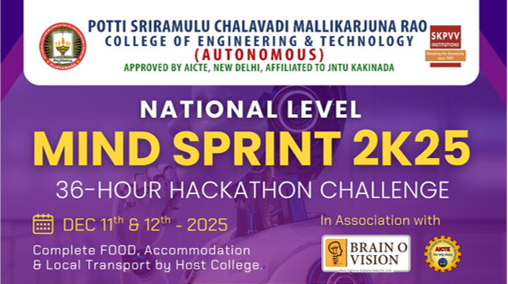
Mindsprint 2k25
Problem Statement Title- Development of a Digital Mental Health and Psychological Support System for Students in Higher Education.
Theme- Other Innovation.
PS Category- Software
Team Name- BuildingBots
Team Members- Sriram Lohith V
Hari kiran J
Kaif sharif SK

Slide 2
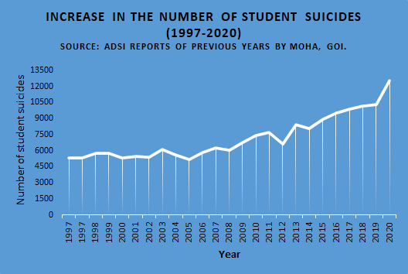
Mindsprint 2k25
Problem Statement Title- Development of a Digital Mental Health and Psychological Support System for Students in Higher Education.
Theme- Other Innovation.
PS Category- Software
Team Name- BuildingBots
Team Members- Sriram Lohith V
Hari kiran J
Kaif sharif SK

Slide 3
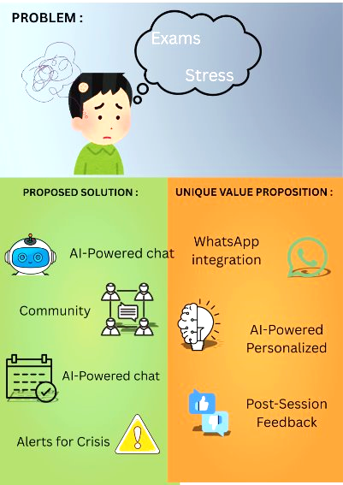
A . P . I . D.
Problem:
Today, many college students are facing serious issues with mental health like anxiety, depression and stress. However there is a lack of mental health services in the most higher education institutions, especially in rural and semi-urban colleges. The stigma of mental illness acts as a major barrier, which often makes students hesitant to seek support.(Lattie et al., 2020)
Proposed Solution:
A safe AI-powered chat to track mental health.
Students can book online/offline appointments.
A library of resources for a quick relief and wellness tips.
Immediate alerts for crisis situations, with admin dashboard for college to monitor overall student wellness.
Unique value Proposition:
Integrating with WhatsApp, making mental health support as easy as sending a message.
AI-Powered Personalized Resource Engine that learns from your conversions to provide personalized resources when you need it.
Our chatbot applies proven CBT techniques to help students manage their anxiety and depression.
Post Session feedback for support.

Slide 4
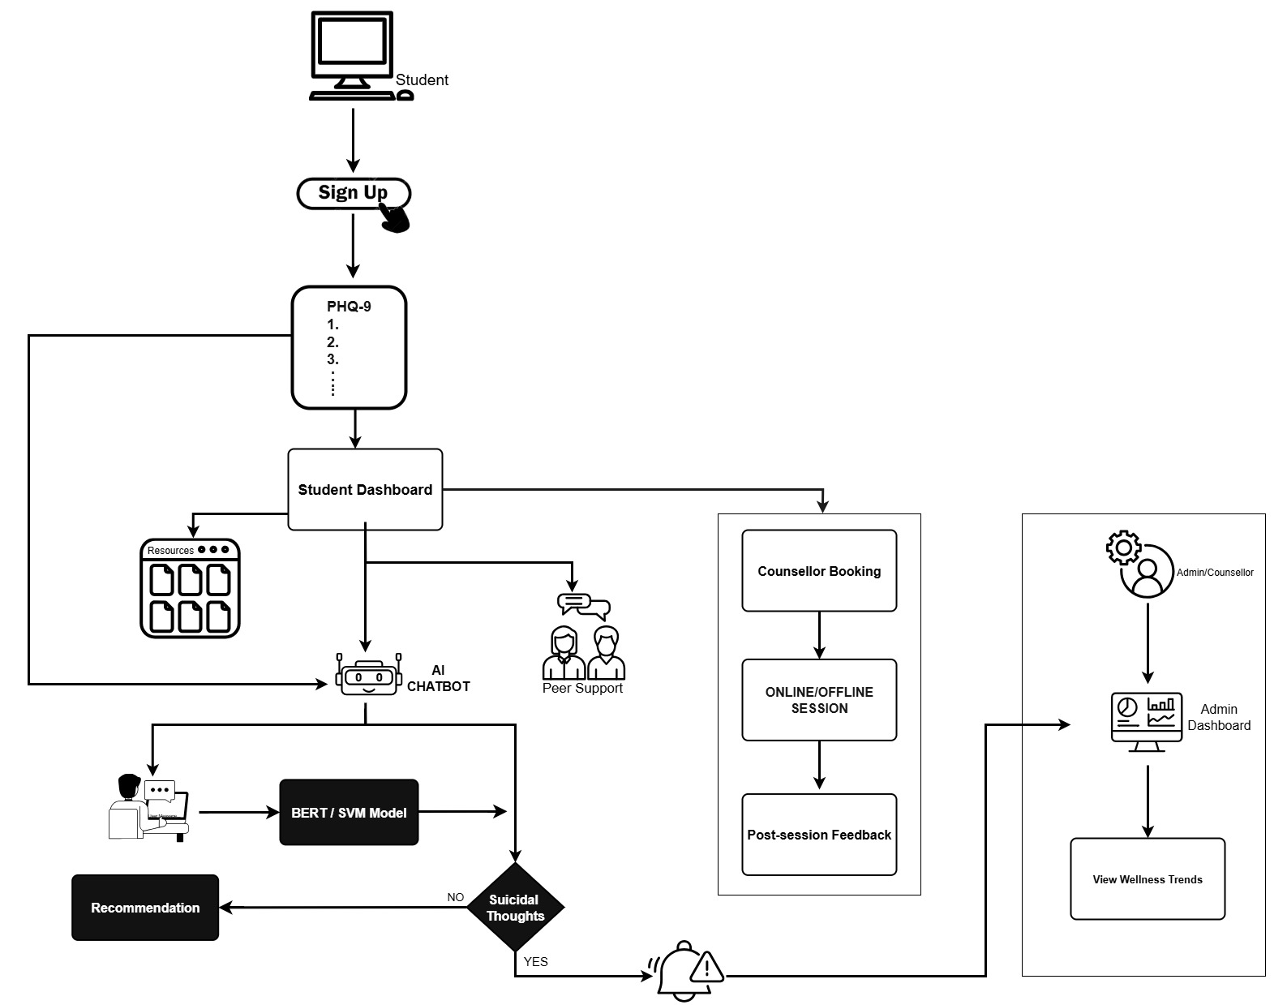
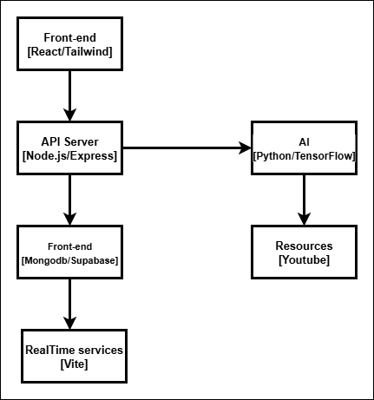
TECHNICAL APPROACH
User Flow
Infra Structure
Database

Slide 5
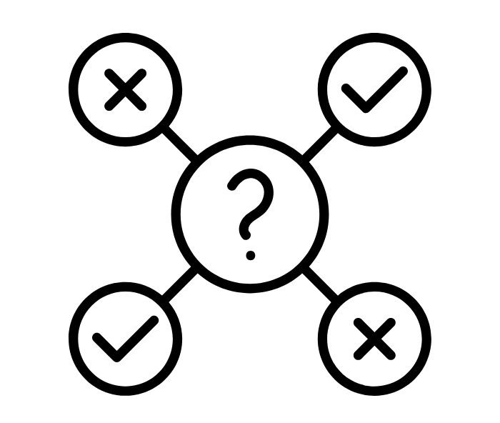
Feasibility:
The project uses technologies like React and Python and relies on proven AI models.
The Project has tested its core AI models, achieving an 87.5% accuracy rate in student emotion detection, which demonstrates that the technology works and can be a reliable tool for real-time emotional support.(Lattie et al., 2020)
Challenges and Risks:
One of the challenge, integrating the platform into university system.
Difficulty in getting students to use the platform consistently.
The risk of the AI misidentifying a student’s emotional state.
Strategies to Overcome Them:
Build features that directly integrate with campus services.
A community section to boost engagement.
Use a human safety net that alerts admins in a crisis.

Slide 6





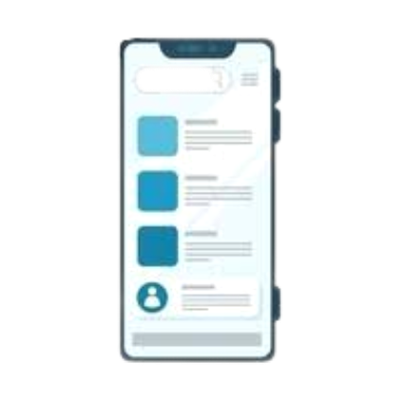



IMPACT AND BENEFITS
Social
Benefits
Economic
Benefits
Education
Benefits
Technological
Benefits
Potential impact on the
Target Audience(Students)
Provides students with instant support for mental health issues like anxiety and burnout, available whenever they need it.
Offers an anonymous community and a private chatbot, making it easier for students to seek help without fear of judgment.(Lattie et al., 2020)
The platform consists of a range of resources like videos, calming audios, and guided meditations to help students improve their mental state.
Ensures that students in crisis receive immediate attention by automatically alerting college administrators.
When a college helps its students, it gets a better reputation for caring in the society.
Personalized and fast help
Low cost solution
Resources
Better jobs after graduation

Slide 7
REFERENCES
Lattie, E. G., Kornfield, R., Ringland, K. E., Zhang, R., Winquist, N., & Reddy, M. (2020). Proceedings of the 2020 CHI conference on human factors in computing systems, 1-15.
Google. BERT-base-uncased. Hugging Face. Retrieved from https://huggingface.co/google-bert/bert-base-uncased​
ali, E. (2023). Sentiment Analysis for Mental Health . Kaggle. Retrieved from https://www.kaggle.com/datasets/engsaiedali/sentiment-analysis-for-mental-health​
Canvas [Icons and images used in the project]. Retrieved from https://www.canva.com/en_in/

